Slide 1
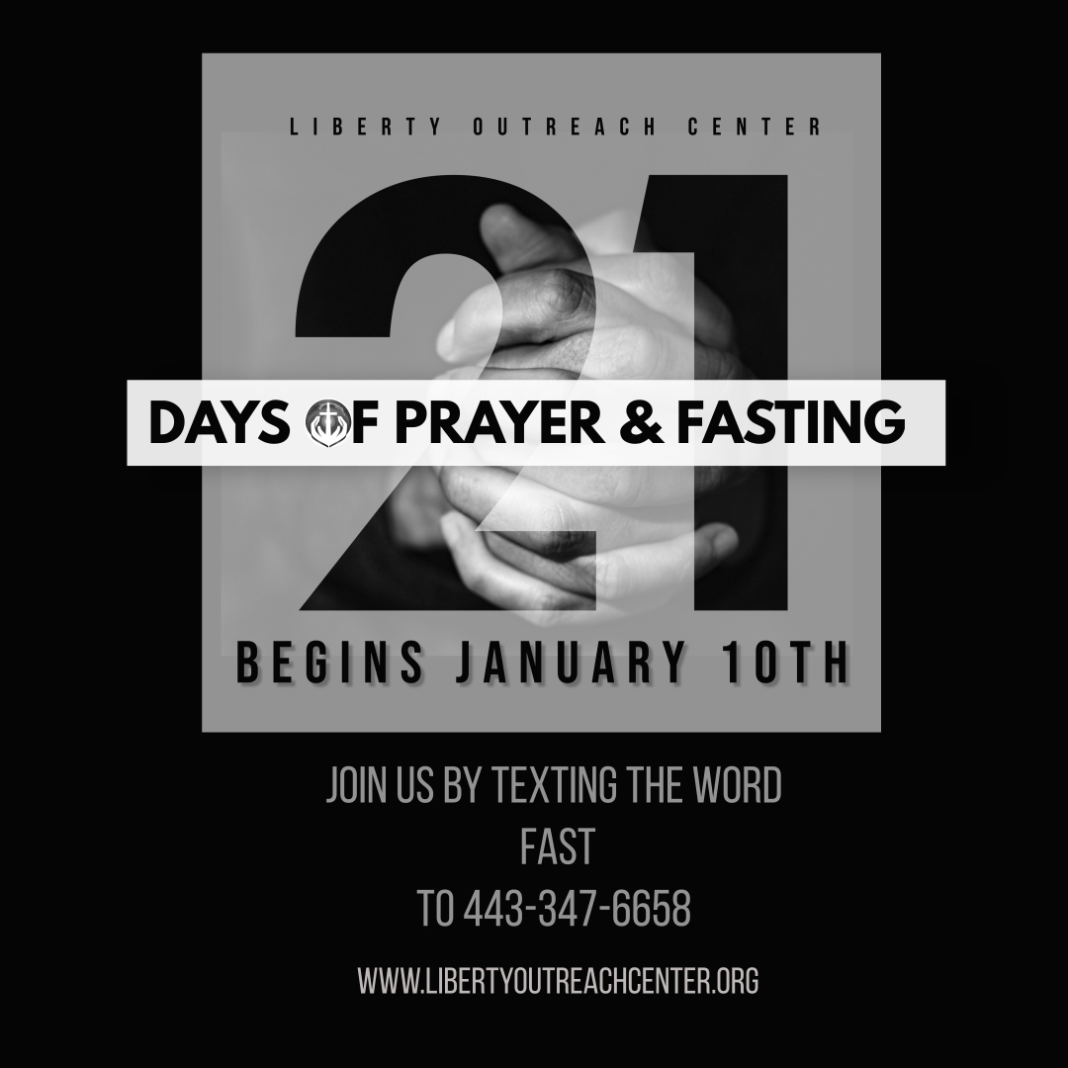
Capital Campaign Recap!
Wear
YOUR PJ’s
&
JOIN US!!

Slide 2
Capital Campaign Recap!
Wear
YOUR PJ’s
&
JOIN US!!

Slide 3
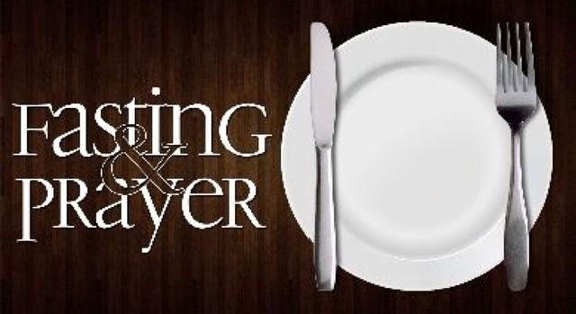
21 DAYS
January 10th – January 30th
TNT-Tuesday January- 9th
Notes:
Kids Fasting & Prayer Documents are posted on the website…. So that They can Begin Tomorrow on the 12th Too!!!

Slide 4
Tonight's Objective’s
What Is It? & Why Do We Do it? (Fasting)
Types of Fasting (Pick One)
What to Fast From (Pick that Too)
Timing of Fast
Prayer

Slide 5
FASTING!!!
The goal of fasting is to draw nearer to God. Biblical fasting always has to do with Eliminating Distractions for a spiritual purpose; it hits the reset button of our soul and renews us from the inside out. It also enables us to celebrate the Goodness and Mercy of God and prepares our hearts for all the Good things God desires to bring into our lives.
Notes:
Fasting… Willful REFRAIN!!!

Slide 6
Matthew 4: 1 - 4
1 Then Jesus was led by the Spirit into the wilderness to be tempted there by the devil. 2 For forty days and forty nights he fasted and became very hungry.
3 During that time the devil came and said to him, “If you are the Son of God, tell these stones to become loaves of bread.”
4 But Jesus told him, “No! The Scriptures say, ‘People do not live by bread alone,
but by every word that comes from the mouth of God.
Notes:
Jesus fasted and prayed for 40 days and 40 nights to prepare for the ministry God assigned to him. In the New Testament, the gospels of Luke, Mark and Matthew have passages that refer to Jesus' stay in the wilderness. His time in the desert occurs after his baptism by John the Baptist.
After JESUS was Baptized He Fasted & Prayed!
During those forty days, when Jesus’ flesh was at its weakest, He endured relentless temptation from Satan. Satan offered Him alternatives to God’s plan, compromises that would satisfy His natural desires, and attacks upon His very identity as the Son of God (Matthew 4:3). Jesus used the Word of God, not His own strength, to defeat those temptations and remain victorious over sin. He demonstrated for us that fasting can strengthen us spiritually when we use it to draw closer to God. After Jesus’ fast, the devil left Him and “angels came and attended him” (Matthew 4:11). Luke 4:14 concludes the account of this testing time by saying, “Jesus returned to Galilee in the power of the Spirit.” He had conquered temptation and was ready to embrace the purpose for which the Father had sent Him. He would not rely on His humanity to perform miracles, deliver the oppressed, or defeat death. Fasting was a way to declare mastery over His human nature so that He would live every moment directed by the “power of the Spirit” (Luke 10:21). He set the example for us who “are not in the realm of the flesh but are in the realm of the Spirit” (Romans 8:9). If the Son of God did not rely on His flesh to live in obedience to God, then we can’t either.

Slide 7
Matthew 6:16-18
16 “And when you fast, don’t make it obvious, as the hypocrites do, for they try to look miserable and disheveled so people will admire them for their fasting. I tell you the truth, that is the only reward they will ever get. 17 But when you fast, comb your hair[a] and wash your face. 18 Then no one will notice that you are fasting, except your Father, who knows what you do in private. And your Father, who sees everything, will reward you.
Notes:
Jesus is Teaching here on Fasting…
Fasting, Gives Us Times to Pray!!! Teaches Us Self –Discipline., and Reminds Us that We Can TRULY ACTUALLY LIVE WITH A LOT LESS!!! Helping Us to Appreciate Gods Gifts to us!! Shelter, Clothing, Food, Money we already have.. Basic Necessities of Life…
Jesus here is condemning Hypocrisy!!! Fasting only in order to gain public approval!!!
The Pharisees would fast voluntarily twice a week to impress the people with their “Holiness”… Their Look…
Jesus Commended More acts of self-sacrifice done quietly and sincerely (YOUR COMMITMENT IS YOUR COMMITMENT…BETWEEN YOU AND GOD)
More than Anything…JESUS wanted People to adopt Spiritual Disciplines for the RIGHT REASONS!!!, and Not from Selfish Desire for Praise!!!

Slide 8
TYPES OF FAST
Your personal fast should present a level of challenge, but it is very important to know your body, your options, and most importantly, to seek God in prayer and follow what the Holy Spirit leads you to do.
Notes:
Fasting… Willful REFRAIN!!!
If your taking medications you may need to modify some things on your fast!!
Use Wisdom!!! & The most Important Piece is to Just Be HONEST With GOD!!! & YOURSELF!!!!!

Slide 9
COMPLETE FAST
In this type of fast, you drink only liquids, typically water with light juices or tea as an option.

Slide 10
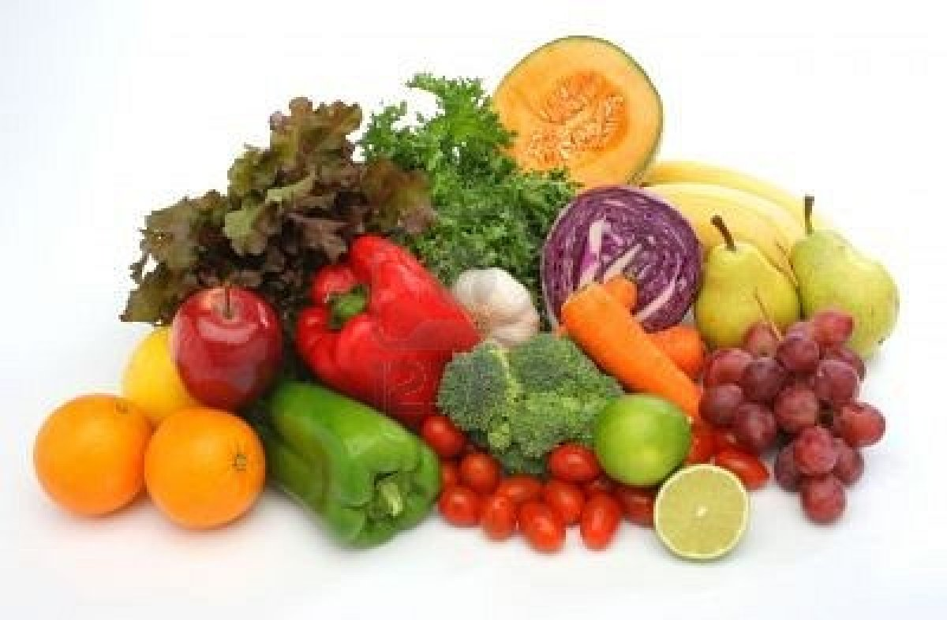
SELECTIVE FAST
This type of fast involves removing certain elements from your diet. One example of a selective fast is the Daniel Fast, during which you remove meat, sweets, and bread from your diet and consume water and juice for fluids and fruits and vegetables for food.
Notes:
The type of fast God wants you to undertake (such as water only, or water and juices; what kinds of juices you will drink and how often)

Slide 11
SOUL FAST
This fast is a great option if you do not have much experience fasting food, have health issues that prevent you from fasting food, or if you wish to refocus certain areas of your life that are out of balance. For example, you might choose to stop using social media or watching television for the duration of the fast and then carefully bring that element back into your life in healthy doses at the conclusion of the fast.

Slide 12
Examples of Soul Fast….

Slide 13
FINANCIAL FAST
Our financial health is important to God. This fast is a great option for those who are trying to become better stewards over their finances while willfully gaining financial freedom. In other words, become financially healthy. This will help you focus or refocus on how to spend money wisely with discipline relying less and less on credit and debit card transactions. A total DETOXIFICATION of our wallets ladies and gentlemen.
Notes:
As believers we put our Hope in God but that doesn’t mean that we shouldn’t continuously plan ahead for the future by saving,and investing. That is why the Financial Fast is Great for starting emergency funds, starting or replenishing savings, education, paying off bills, travel expenses, paying tithes and offerings and creating budgets that fit our everyday living. From a Biblical perspective, how we manage our finances affects every aspect of our lives. We should not be robbing Peter to pay Paul. That mentality has been passed down from many generations leading us into financial debt. That financial debt can put us on a path to financial destruction and ruin ultimately keeping us anxious, depressed, overwhelmed and stressed. For those of us who are married know that poor financial habits can ultimately lead to separation or divorce. The Bible has many verses that deal with our finances but I am going to add share 21 scriptures by number chapter and verse only on the next slide. If you do decide to do the Financial Fast you will be encouraged to keep good records of your spending while creating a budget so that you can become a better steward of your finances. If you are use to spending at will the first couple of days or maybe even weeks will be difficult. However, if you push through the Financial fast knowing that God wants His Best for your freedom is just on the other side.

Slide 14
FINANCIAL FAST
For 21 Days, funds may be allocated for emergency or essential items only.
These items are defined as food from the grocery store (no going to the grocery store because of acquired taste), hygiene, school supplies, cleaning supplies, medicine/medical supplies only.
Build a weekly or bi- weekly budget
No going to the mall, retain establishments, online or window shopping.
No restaurant, carry out or delivery meals including fast food and coffee.
No movies or purchasing gifts or gift cards.
No credit card or debit card use. Use cash only.
This Photo by Unknown Author is licensed under CC BY-NC-ND

Slide 15
FINANCIAL FAST SCRIPTURES
Genesis 41:34-36
Malachi 3:8-12
Proverbs 10:4-5
Proverbs 13:11
Proverbs 14:29
10. Proverbs 21:5
11. Proverbs 21:20
13. Proverbs 24:27
14. Ecclesiastes 11:2
15. Matthew 6:24
16. Matthew 25:14-30
17. Luke 14:28-30
18. 1 Corinthians 16:2
19. Colossians 3:17
20. Romans 13:5
21. Hebrews 13:8

Slide 16
TIMING OF FAST
21 Days (Wed, January 10th – Tues, January 30th)
Timing of fast: DAILY 6 AM – 6 PM
At LOC, We begin to encourage corporate fasting for 21 days each year in the month of January. A season of focused prayer as we attentively gravitate this year towards our 2024 theme; “JESUS! SAY HIS NAME”.
Remember; The timing of your fast is not as important as the strength of your focus on God as you fast.
Notes:
It’s very typical to fast a single meal, a whole day, or three days or more.
6AM – 6PM
How long you will fast—one meal, one day, a week, several weeks, forty days (Beginners should start slowly, building up to longer fasts.)

Slide 18
NUMBER TO DIAL IN (971) 379-9349
CORPORATE PRAYER TIMES!!!
DAILY (MONDAY – SATURDAY) 6AM & 6 PM
Notes:
Remember to Pray Always!!!
When its Get Hard & Set A Prayer Time!! / Schedule

Slide 19
My 21 Day Commitment!!!
I ______________________________________ (insert name), commit to 21 Days of Fasting & Prayer with my Liberty Outreach Center Church Family.
On this day January 9th, I commit to begin on January 10th through January 30th, a full 21 days to this type of Fasting ____________________________.
(Insert Selected Type of Fast)
Notes:
By now you all should have filled this form out and put it inside of a close envelope.

Slide 20
My 21 Day Commitment!!!
Beginning January 10th, I commit to Fast From: ___________________________________________________________________________________________________________________________________ (List What You Will Be Specifically Fasting From)
After my 21st day, my Declaration of Faithfulness to God will be: (Daniel 1:8-17)
­­­­­­­­­­­­­­­___________________________________________

Slide 21
Capital Campaign Recap!
Wear
YOUR PJ’s
&
JOIN US!!

